Slide 1
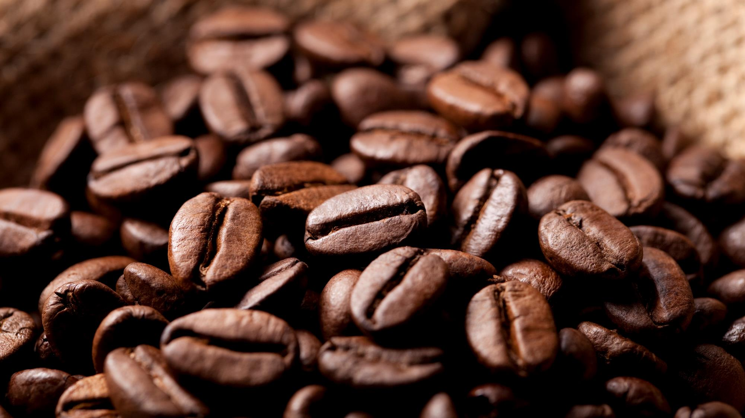
Bright Coffee Shop
Sales Analysis
By Lungile Chirwa

Slide 2
Bright Coffee Shop is a morning-focused, beverage-led business with significant untapped potential in afternoon and evening periods. We generate R698,812 in revenue across 3 locations but 55% of that revenue happens in just one-third of our operating day. This presentation reveals how our morning dominance creates both our greatest strength and our biggest growth opportunity. By understanding what we sell best, when we sell it, and where we excel, we can unlock an estimated R465,000 in untapped revenue potential.

Slide 3
Top 3 products
Coffee brings in 40% + and Tea 30% in revenue so we should continue to focus on these and add promotions, loyalty programmes.
Large “LG” size drives the coffee/tea success, If we convert 50% of Regular (RG) sales to Large (LG), we unlock +10% average transaction value without adding a single customer.
Morning dominance

Slide 4
Competitive Lands Three insights will define Bright Coffee Shop's next growth phase:
Firstly ,we are a morning business. 55% of revenue happens before noon.
Secondly, we are a beverage business. Coffee and Tea drive 66% of sales.
Thirdly, we have an execution gap. Our best store outperforms our weakest by R1,625 monthly.
This presentation details how to leverage these insights for immediate impact."

Slide 5
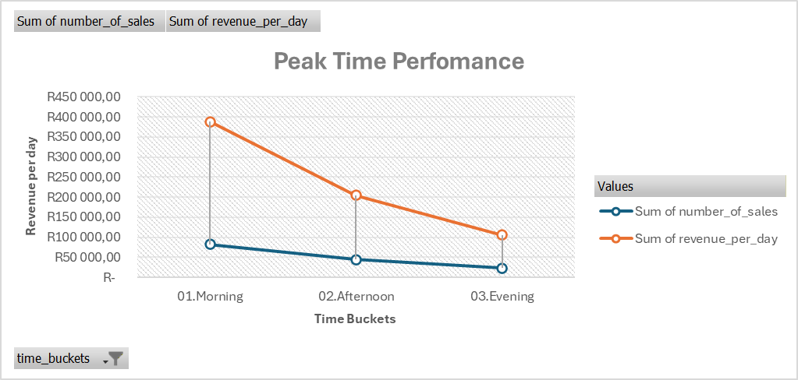
Time patterns Morning engine, evening opportunity
Our customers behave the same way every day, whether it's Monday or Saturday. This predictability is our superpower: we know exactly when to staff, when to promote, and where to grow.

Slide 6


Slide 7
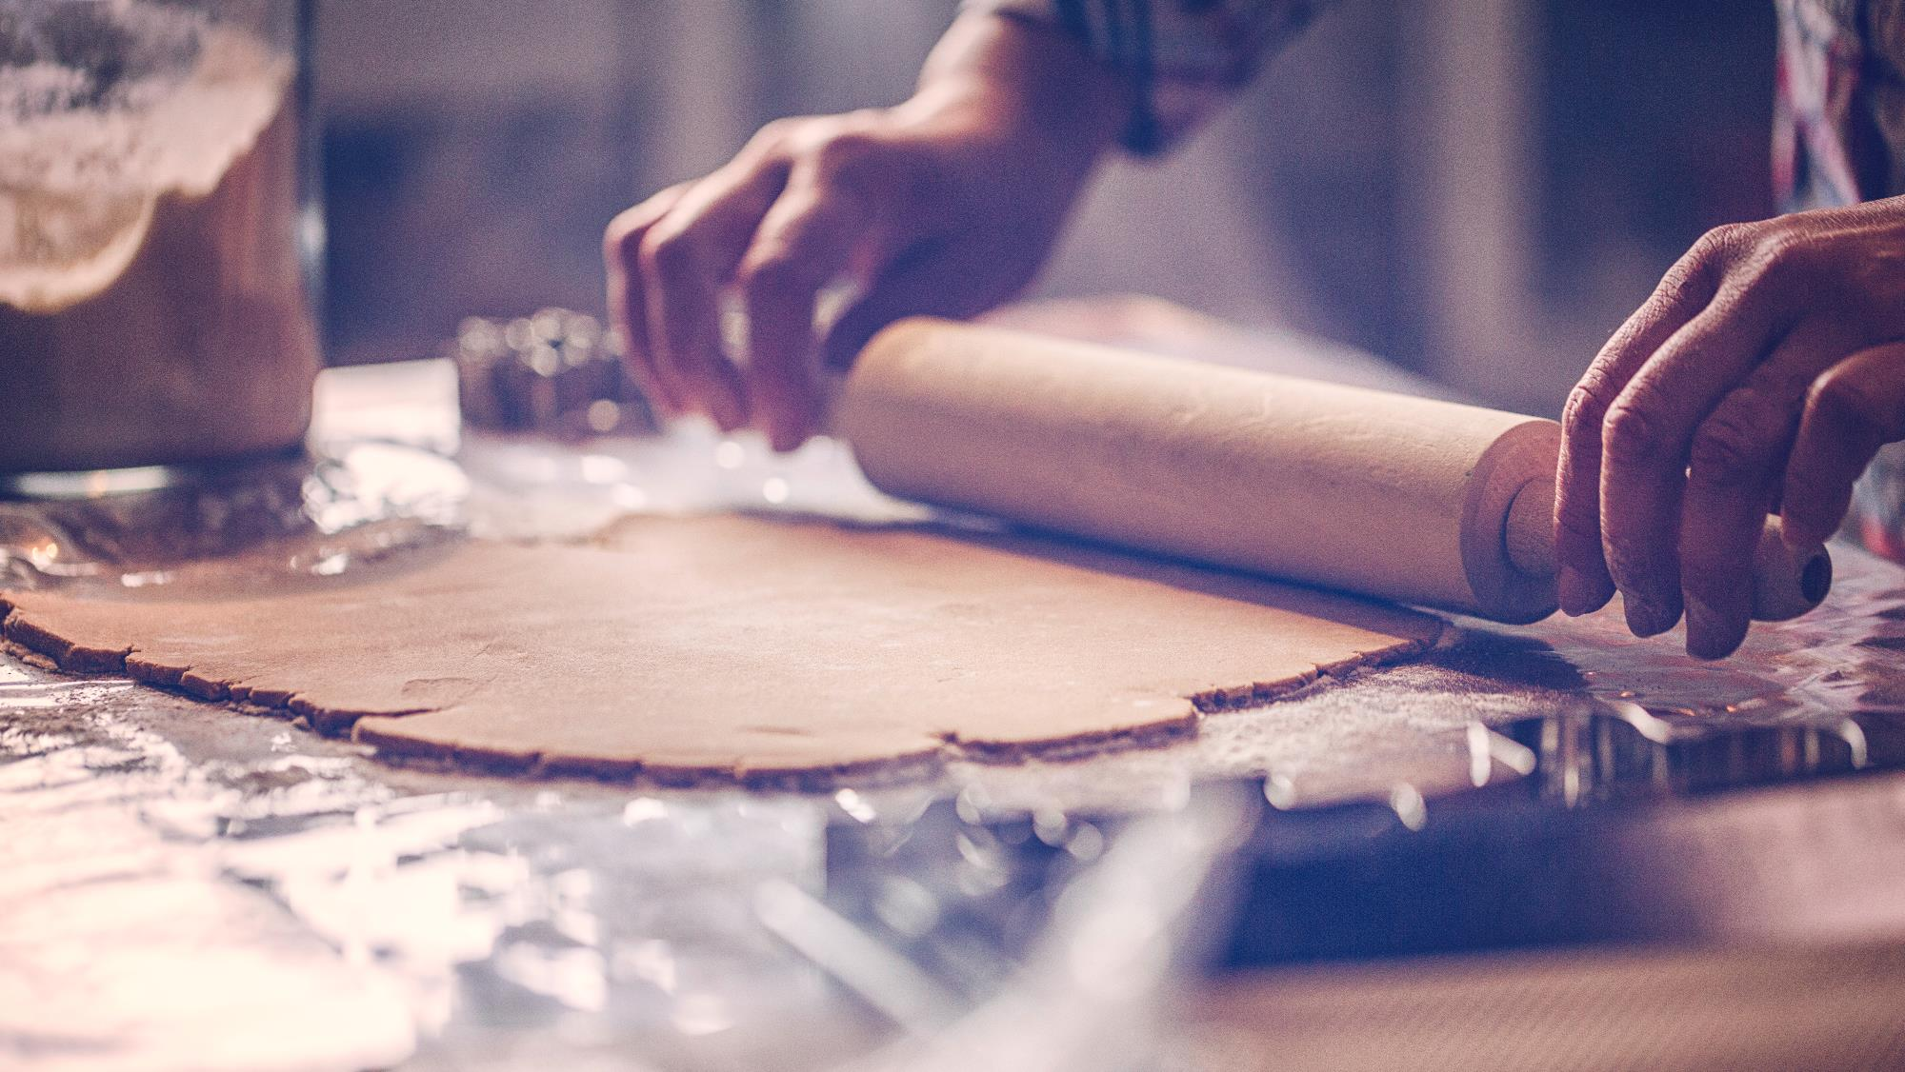
Key to Success
Evening Promotions
Targeted Promotions
Morning Dominance
Better Service
Reduce Complexity

Slide 8
Key to success
Morning Dominance | Protect & expand peak hours
Evening Promotions | Happy hour, events, loyalty
Targeted Promotions | Afternoon revival campaign
Better Service | Faster, friendlier, consistent
Reduce Complexity | Cut underperformers (Packaged Chocolate)

Slide 9

Recommendations
Audit Hells Kitchen’s operations to identify success factors and replicate to the other 2 stores.
Bundle low preforming products with best sellers.
Bundle bakery with morning coffeeDiscontinue Packaged chocolate
Automation and loyalty program

Slide 10
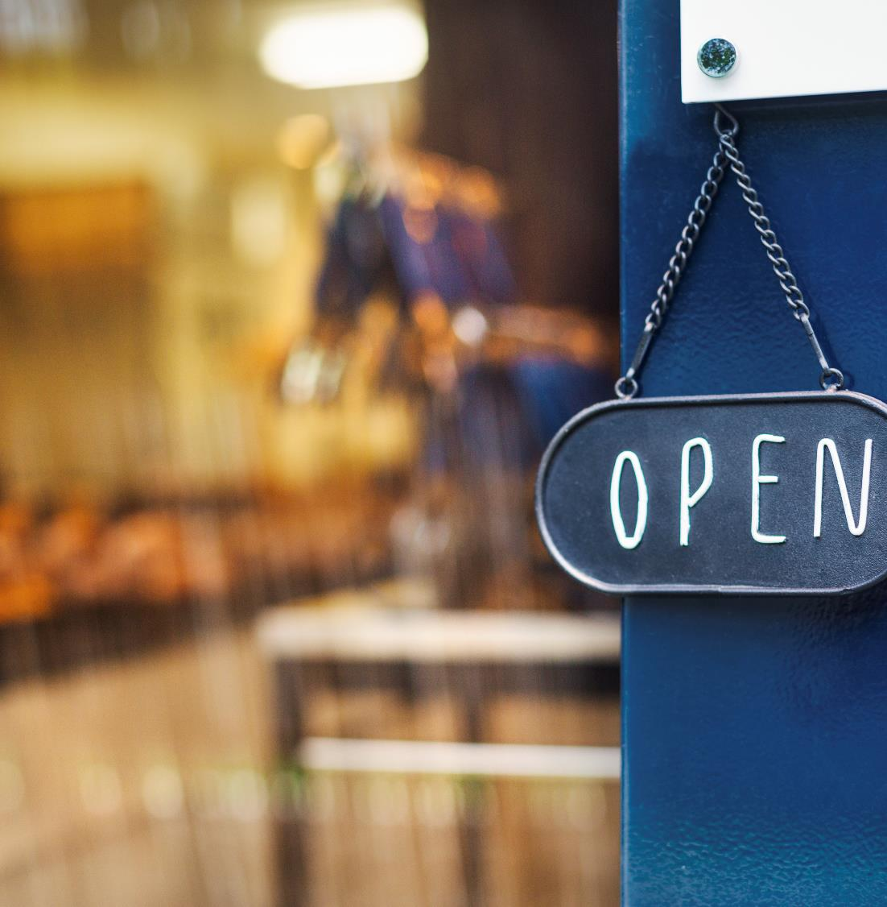
Thank You
Prepared by Lungile Chirwa
31 March 2026
Data Analytics

